Slide 1


Looping statements

Slide 2

Looping statements
A loop statement allows us to execute a statement or group of statements multiple times.

Slide 3

Types of Looping statements
For loop
While loop
Nested loop

Slide 4
For Loop
The for loop in python is used to iterate the statements or part the program several times. It is frequently Used to traverse the data structures like list, tuple, or dictionary.

Slide 5

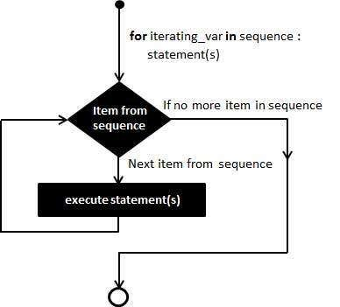
Flowchart

Slide 6

Syntax
for iterating_var in sequence: statements

Slide 7
Example
Write a program to print 1 to 10 series
i=1
For i in range(0,11): Print(i)
Output
0 1 2 3 4 5 6 7 8 9

Slide 8
To print multiplication table
Output
enter no 6
6 X 0 = 0
6 X 1 = 6
6 X 2 = 12
6 X 3 = 18
6 X 4 = 24
6 X 5 = 30
6 X 6 = 36
6 X 7 = 42
6 X 8 = 48
6 X 9 = 54
6 X 10 = 60
i=0
n=int(input("enter no"))
for i in range(0,11):
print("%d X %d = %d" %(n,i,n*i))

Slide 9
Output
Program to Iterating string using for loop
Example
P Y T H O N
str = "PYTHON" for i in str:
print(i)

Slide 10

Program to iterate through a list using indexing
Output
Example
I go to Bhopal
I go to Indore
I go to Gwalior
city = ['Bhopal','Indore', 'Gwalior']
# iterate over the list using index
for i in range(len(city)):
print("I go to", city[i])

Slide 11
While loop
syntax
while ( test_expression): Body of while
Repeats a statement or group of statements while a given condition is TRUE. It tests the condition before executing the loop body.

Slide 12
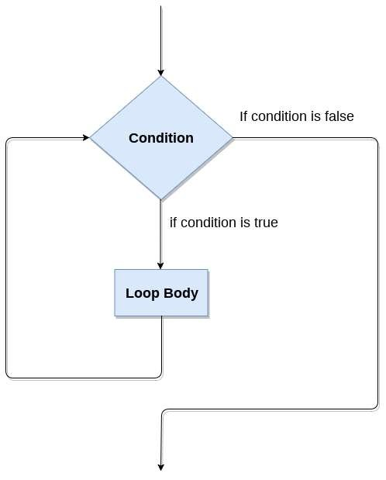
Flow chart

Slide 13
Example
i = 1
while i<6: print(i)
i += 1
Program to print 1 to 5 series
Output
1
2
3
4
5

Slide 14
Program to print list in reverse order
Example
a =[‘stu1',‘stu2',‘stu3']
while a:
(a.pop(-1))
Output
Student3 Student2 Student1

Slide 15
Using if Statement with While Loop
Output
Example
10
9
8
7
6
5
4
3
2
1
n=10
while n > 0:
if n:
print(n)
n -= 1

Slide 16
Using else Statement with While Loop
Python supports to have an else statement associated with a loop statement.
If the else statement is used with a while loop, the else statement is executed when the condition becomes false.

Slide 17
Syntax
while expr: statement(s) else:
additional_statement(s)

Slide 18
Example
Program to print series with else state
count=0
while count<5:
print(count,"is less than 5") count=count+1
else:
Print(count,"is not less than 5")
Output
0 is | less | than | 5
1 is | less | than | 5
2 is | less | than | 5
3 is | less | than | 5
is is | less not | than less | 5 than | 5

Slide 19
Output
Find Even odd no
n = 2
while n<10 :
# Find the mod of 2
if n%2 == 0:
print("The no."+str(n)+"is even")
else:
print("The no."+str(n)+" is odd")
# Increment `n` by 1
n=n+1
The no. 2 is even
The no. 3 is odd
The no. 4 is even The no. 5 is odd The no. 6 is even The no. 7 is odd The no. 8 is even The no. 9 is odd

Slide 20
Nested loop
You can use one or more loop inside any another while, for or do..while loop.
Example
i = 2
print("prime no")
while i<15:
j = 2
while j<=(i/j):
if not(i%j):
break
j=j+1
if j>(i/j):
print(i)
i = i + 1
prime no
2
3
5
7
11
13

Slide 21
Output
Program to print given pattern
5 4 3 2 1
5 4 3 2
5 4 3
5 4
5
while (i<=5):
j=5
while(j>=i):
print(j, end=“ “)
j-=1
print(“\n”)
i+=1
Example

Slide 22
program to print given below pattern
Example
rows = int(input("Enter the rows:"))
# Outer loop will print number of rows
for i in range(0,rows+1):
# Inner loop will print number of Astrisk
for j in range(i): print("*",end =“ “)
print(“\n”)
*
**
***
****
*****

Slide 23
Program to print given pattern
1
22
333
4444
55555
r=int(input("Enter the no. of rows"))
for i in range(0,r+1):
for j in range(i):
print(i,end = '')
print()

Slide 24


